Slide 1
Quiz Game
by Ebrahim Joy
151-15-5112

Slide 2
Introduction
This is the project of quiz game. Here player gets three lives/chances to play, that means player can give two wrong answers but if he/she gives 3rd wrong answer the game will go to the end.

Slide 3
Uniqueness
lives/Chances
Based on 4th subject
Back in main menu

Slide 4
Instructions
AH,1
AH,2
CX
JMP
JE
Many level

Slide 5
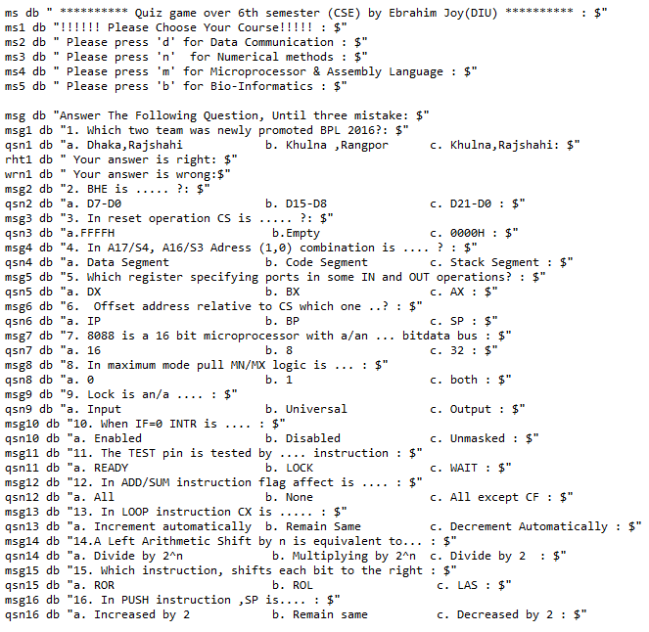
Inside Working
This is the first look of my program

Slide 6
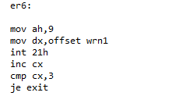
Inside Working(Con.)
Count /three chances

Slide 7
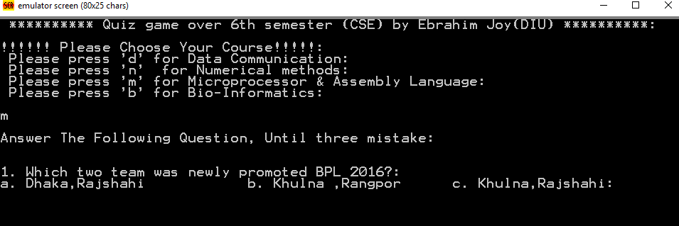
Output Screen
Output of my program

Slide 8
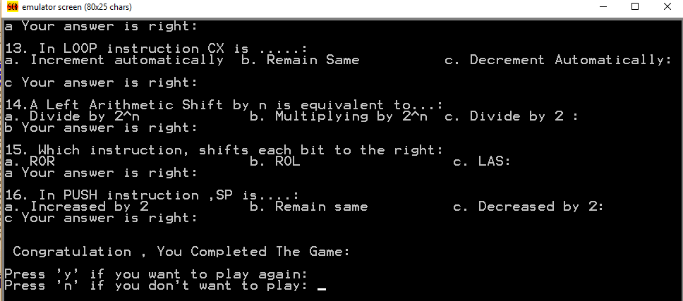
Output Screen(Con.)
Congratulation

Slide 9
Facing Problem
Shortest time
Huge amount of line
Use the CX

Slide 10
Future Plan
Complete 4th subject than more
Add timer
Add Score

Slide 11
Conclusion
This quiz game is interesting game. Besides this we require more knowledge about that subject. It helps to sharp our brain. If I completed my game with my future plan, then it will very helpful to us.

